Slide 1
Taster Workshop

Slide 2
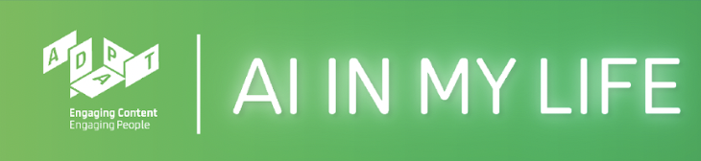

What is AI in My Life?
Workshop series on Artificial Intelligence
Developed by ADAPT research centre and partners
Designed to help students navigate the ’Age of AI’
Our Partners:
This work is licensed under a Creative Commons Attribution-NonCommercial-ShareAlike 4.0 International License
This work is licensed under a Creative Commons Attribution-NonCommercial-ShareAlike 4.0 International License

Slide 3
What you’ll learn today
Learn about AI and how it’s used
Uncover some of the ethical and privacy implications of AI
Evaluate the role of AI in your life and in society
Our Partners:
This work is licensed under a Creative Commons Attribution-NonCommercial-ShareAlike 4.0 International License

Slide 4
A few quick questions
This work is licensed under a Creative Commons Attribution-NonCommercial-ShareAlike 4.0 International License

Slide 5
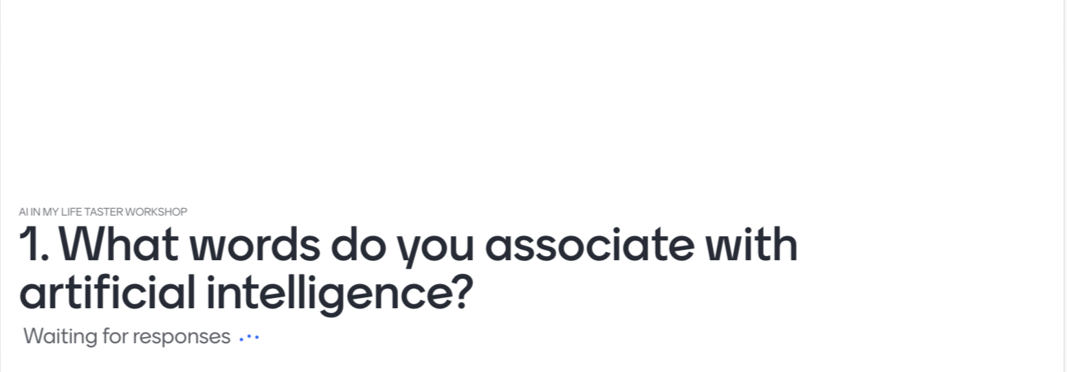
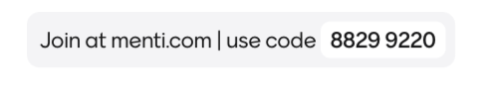
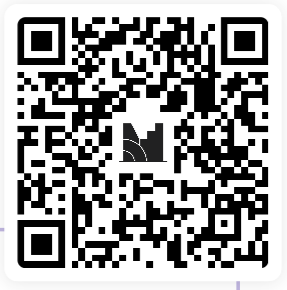
This work is licensed under a Creative Commons Attribution-NonCommercial-ShareAlike 4.0 International License
This work is licensed under a Creative Commons Attribution-NonCommercial-ShareAlike 4.0 International License

Slide 6
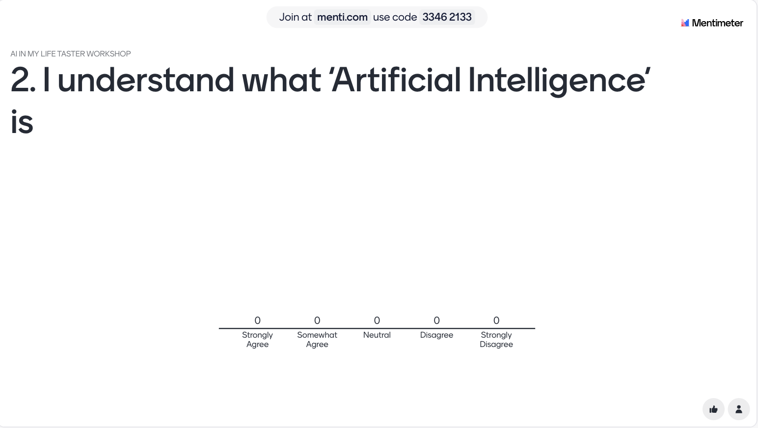
This work is licensed under a Creative Commons Attribution-NonCommercial-ShareAlike 4.0 International License
This work is licensed under a Creative Commons Attribution-NonCommercial-ShareAlike 4.0 International License

Slide 7
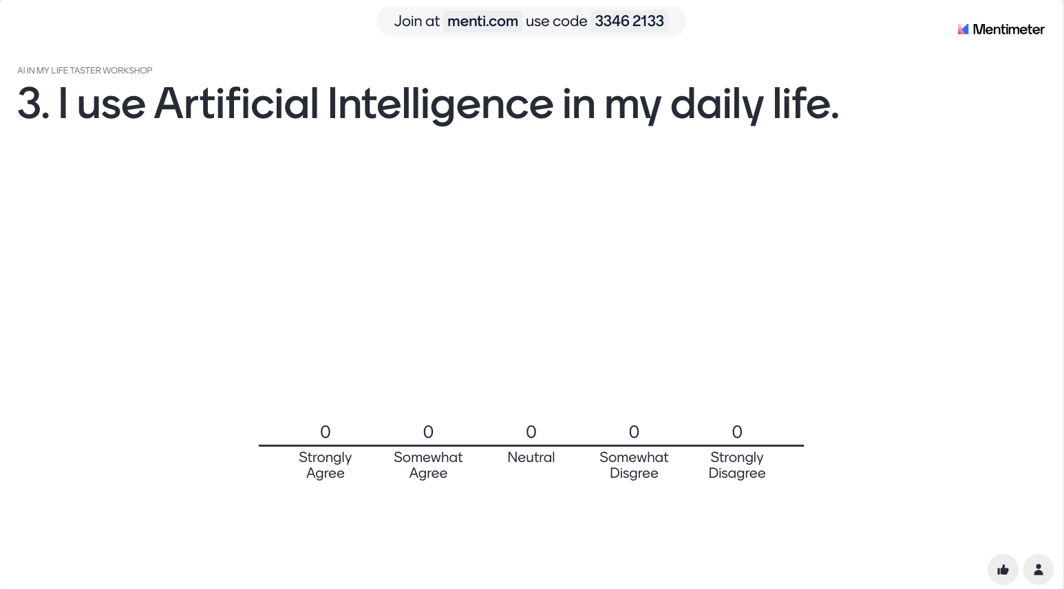
This work is licensed under a Creative Commons Attribution-NonCommercial-ShareAlike 4.0 International License
This work is licensed under a Creative Commons Attribution-NonCommercial-ShareAlike 4.0 International License

Slide 8
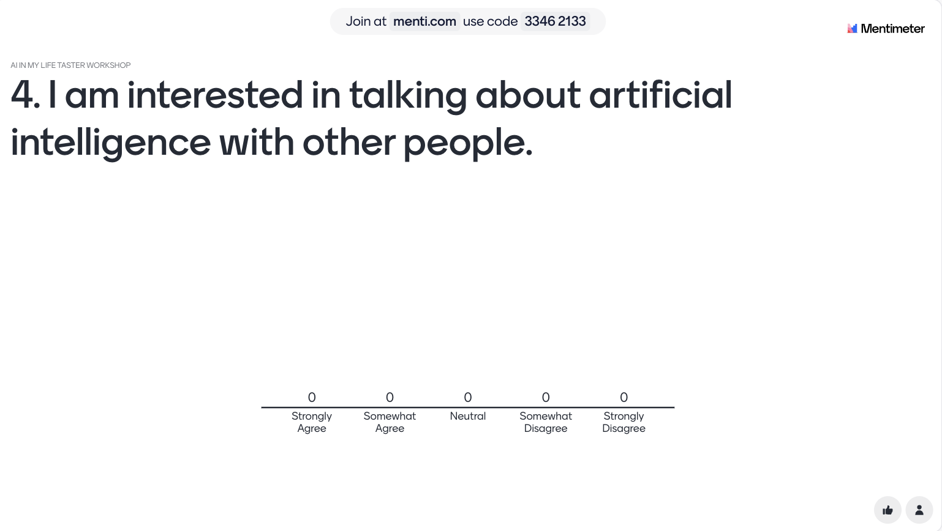
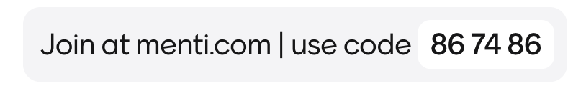
This work is licensed under a Creative Commons Attribution-NonCommercial-ShareAlike 4.0 International License
This work is licensed under a Creative Commons Attribution-NonCommercial-ShareAlike 4.0 International License

Slide 9
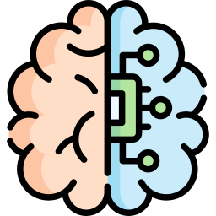
What is AI?
Artificial intelligence refers to many different technologies that are designed to accomplish tasks that can otherwise be only carried out by human minds, for example identifying patterns, recognising images, understanding languages or solving problems.
This work is licensed under a Creative Commons Attribution-NonCommercial-ShareAlike 4.0 International License
This work is licensed under a Creative Commons Attribution-NonCommercial-ShareAlike 4.0 International License

Slide 10
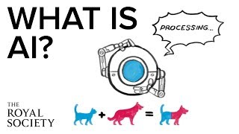
What is AI?
The Royal Society- https://www.youtube.com/watch?v=nASDYRkbQIY&feature=emb_imp_woyt
This work is licensed under a Creative Commons Attribution-NonCommercial-ShareAlike 4.0 International License

Slide 11
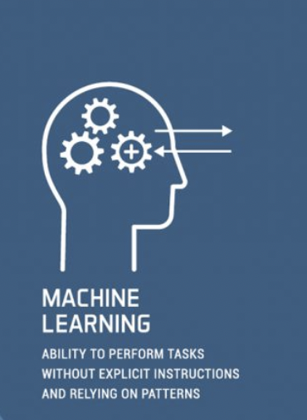
Machine Learning
In the 1950s AI pioneer Arthur Samuel defined Machine Learning as
“the field of study that gives computers the ability to learn without explicitly being programmed.”
This work is licensed under a Creative Commons Attribution-NonCommercial-ShareAlike 4.0 International License

Slide 12
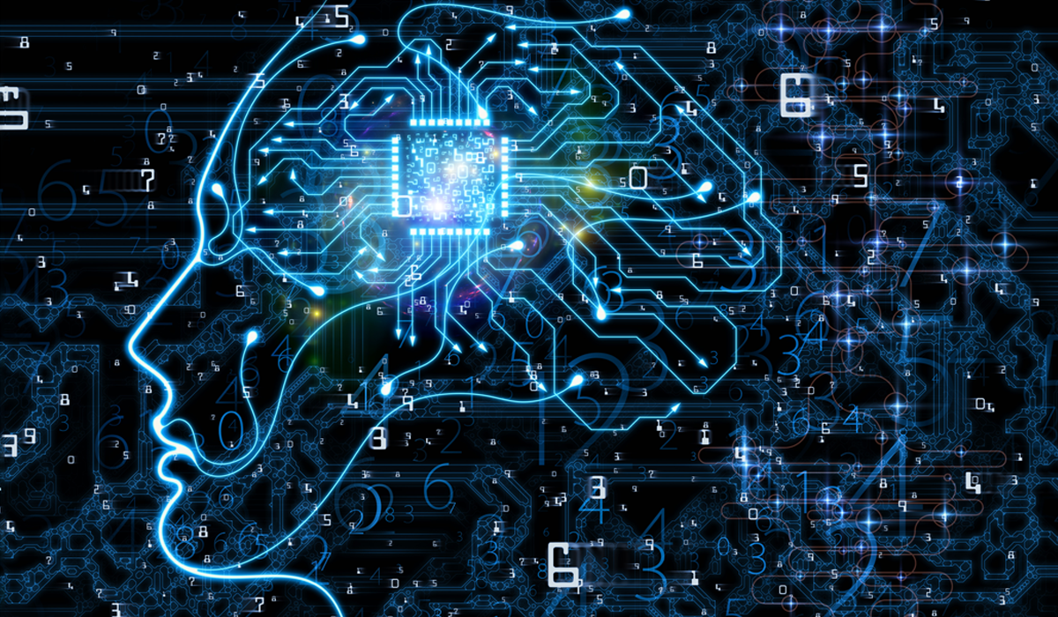
Machine Learning
Where might we use machine learning in our daily lives?
This work is licensed under a Creative Commons Attribution-NonCommercial-ShareAlike 4.0 International License

Slide 13
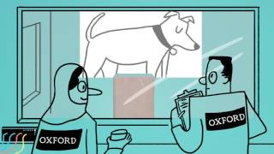
Machine Learning
https://www.youtube.com/watch?v=f_uwKZIAeM0
This work is licensed under a Creative Commons Attribution-NonCommercial-ShareAlike 4.0 International License

Slide 14
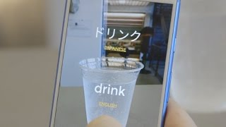
Machine Learning Examples
Take out your phones/tablets and go to:
https://thing-translator.appspot.com/
This work is licensed under a Creative Commons Attribution-NonCommercial-ShareAlike 4.0 International License

Slide 15

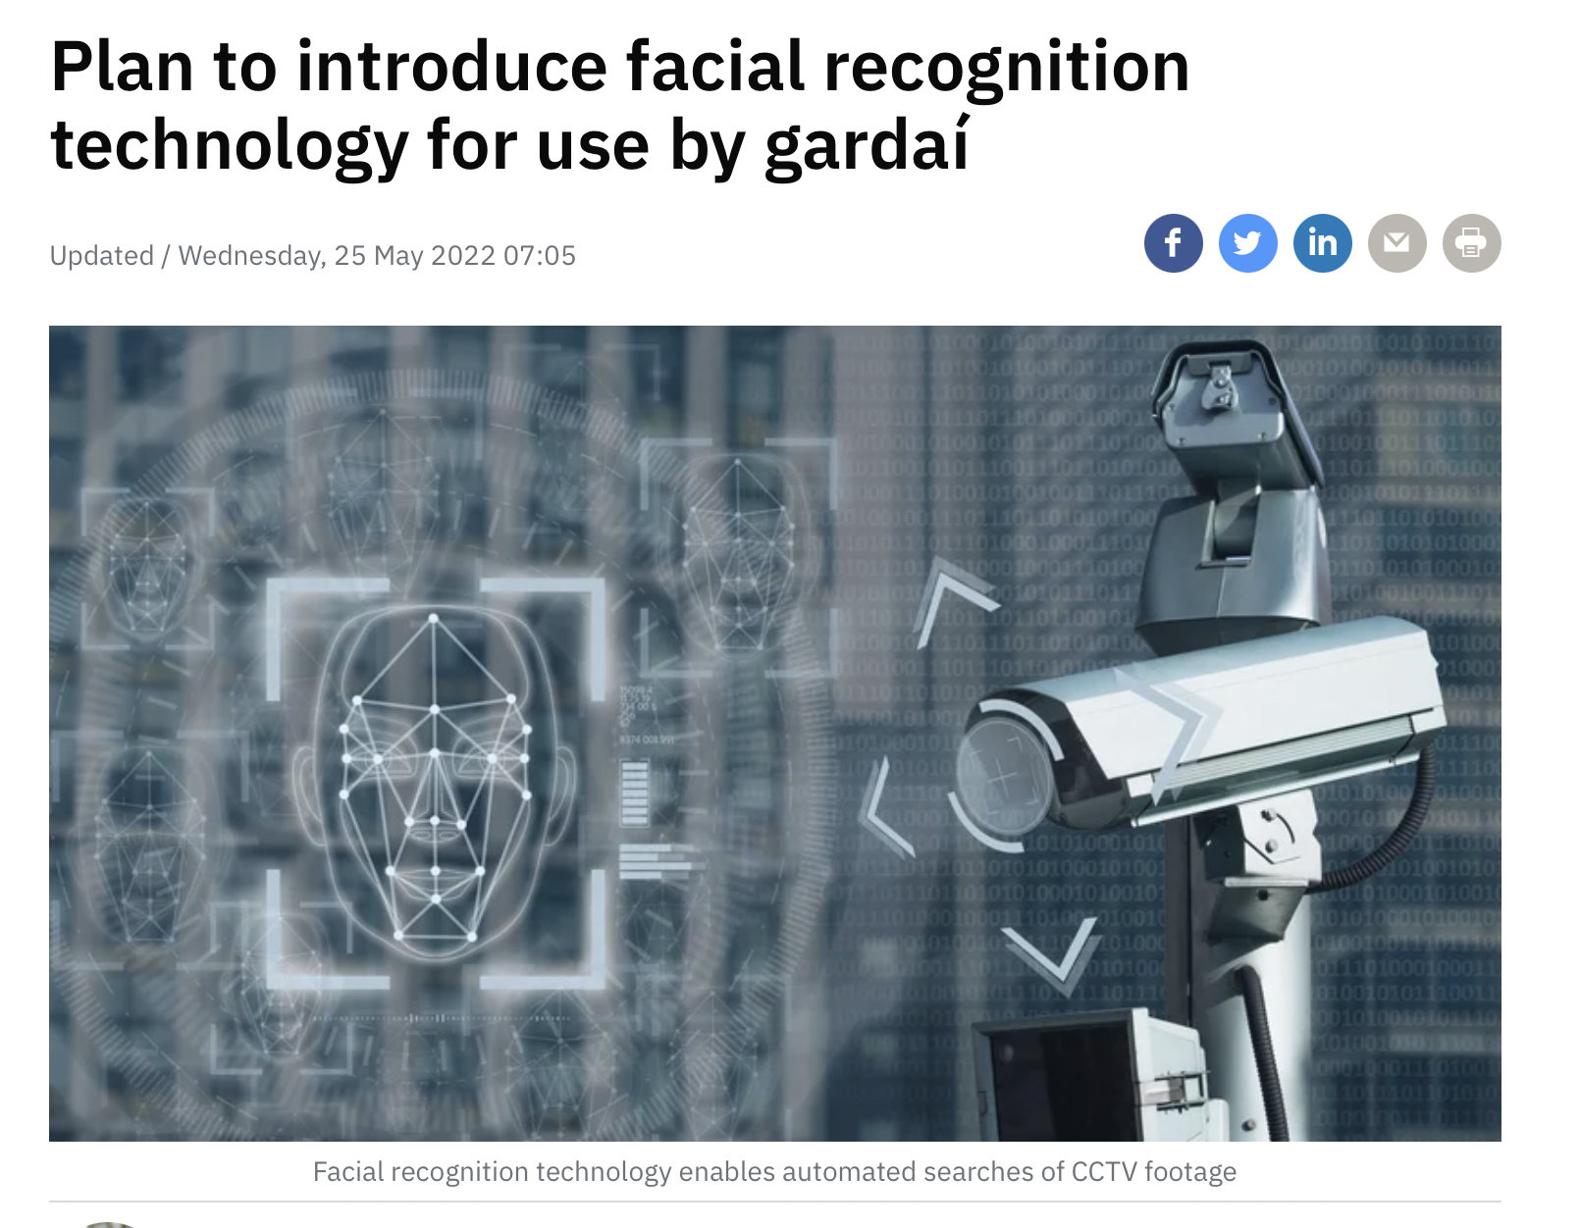
Facial Recognition
This work is licensed under a Creative Commons Attribution-NonCommercial-ShareAlike 4.0 International License

Slide 16
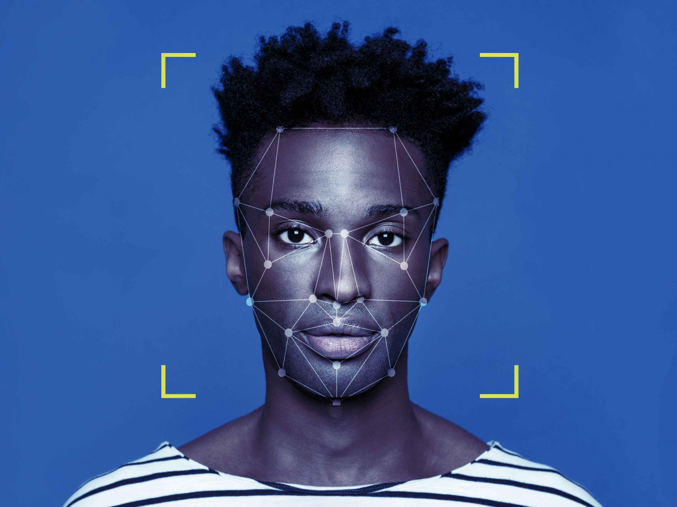
Emotion Detection
This work is licensed under a Creative Commons Attribution-NonCommercial-ShareAlike 4.0 International License

Slide 17

Emotion Detection
Use the below link on your phone or laptop. Follow the instructions on the webpage.
Financial Times Emotion Detection
https://ig.ft.com/emotion-recognition/
This work is licensed under a Creative Commons Attribution-NonCommercial-ShareAlike 4.0 International License

Slide 18
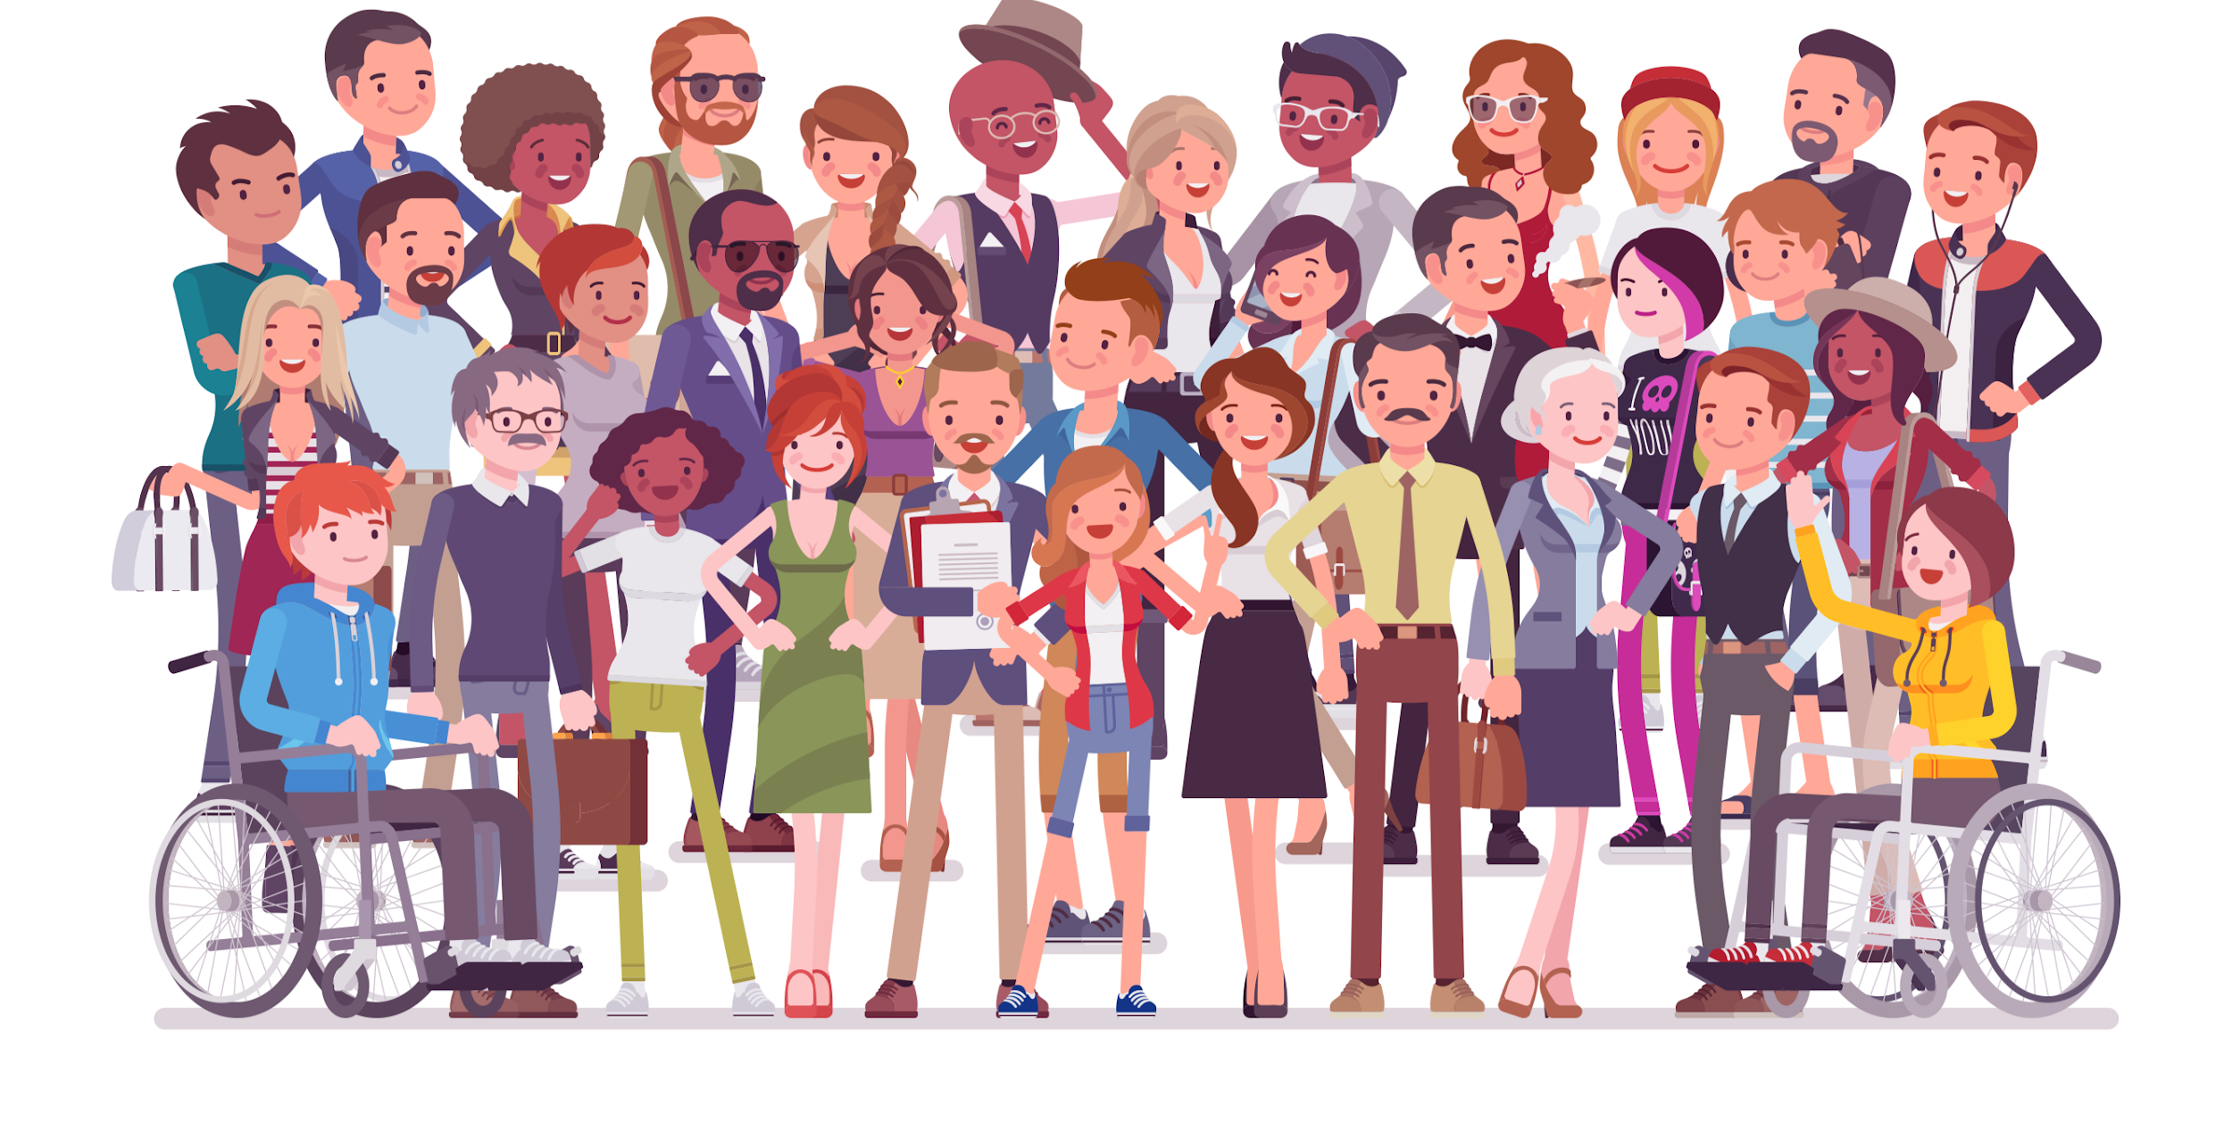
Could AI be biased?
“We don't see things as they are, we see them as we are.”
This work is licensed under a Creative Commons Attribution-NonCommercial-ShareAlike 4.0 International License

Slide 19
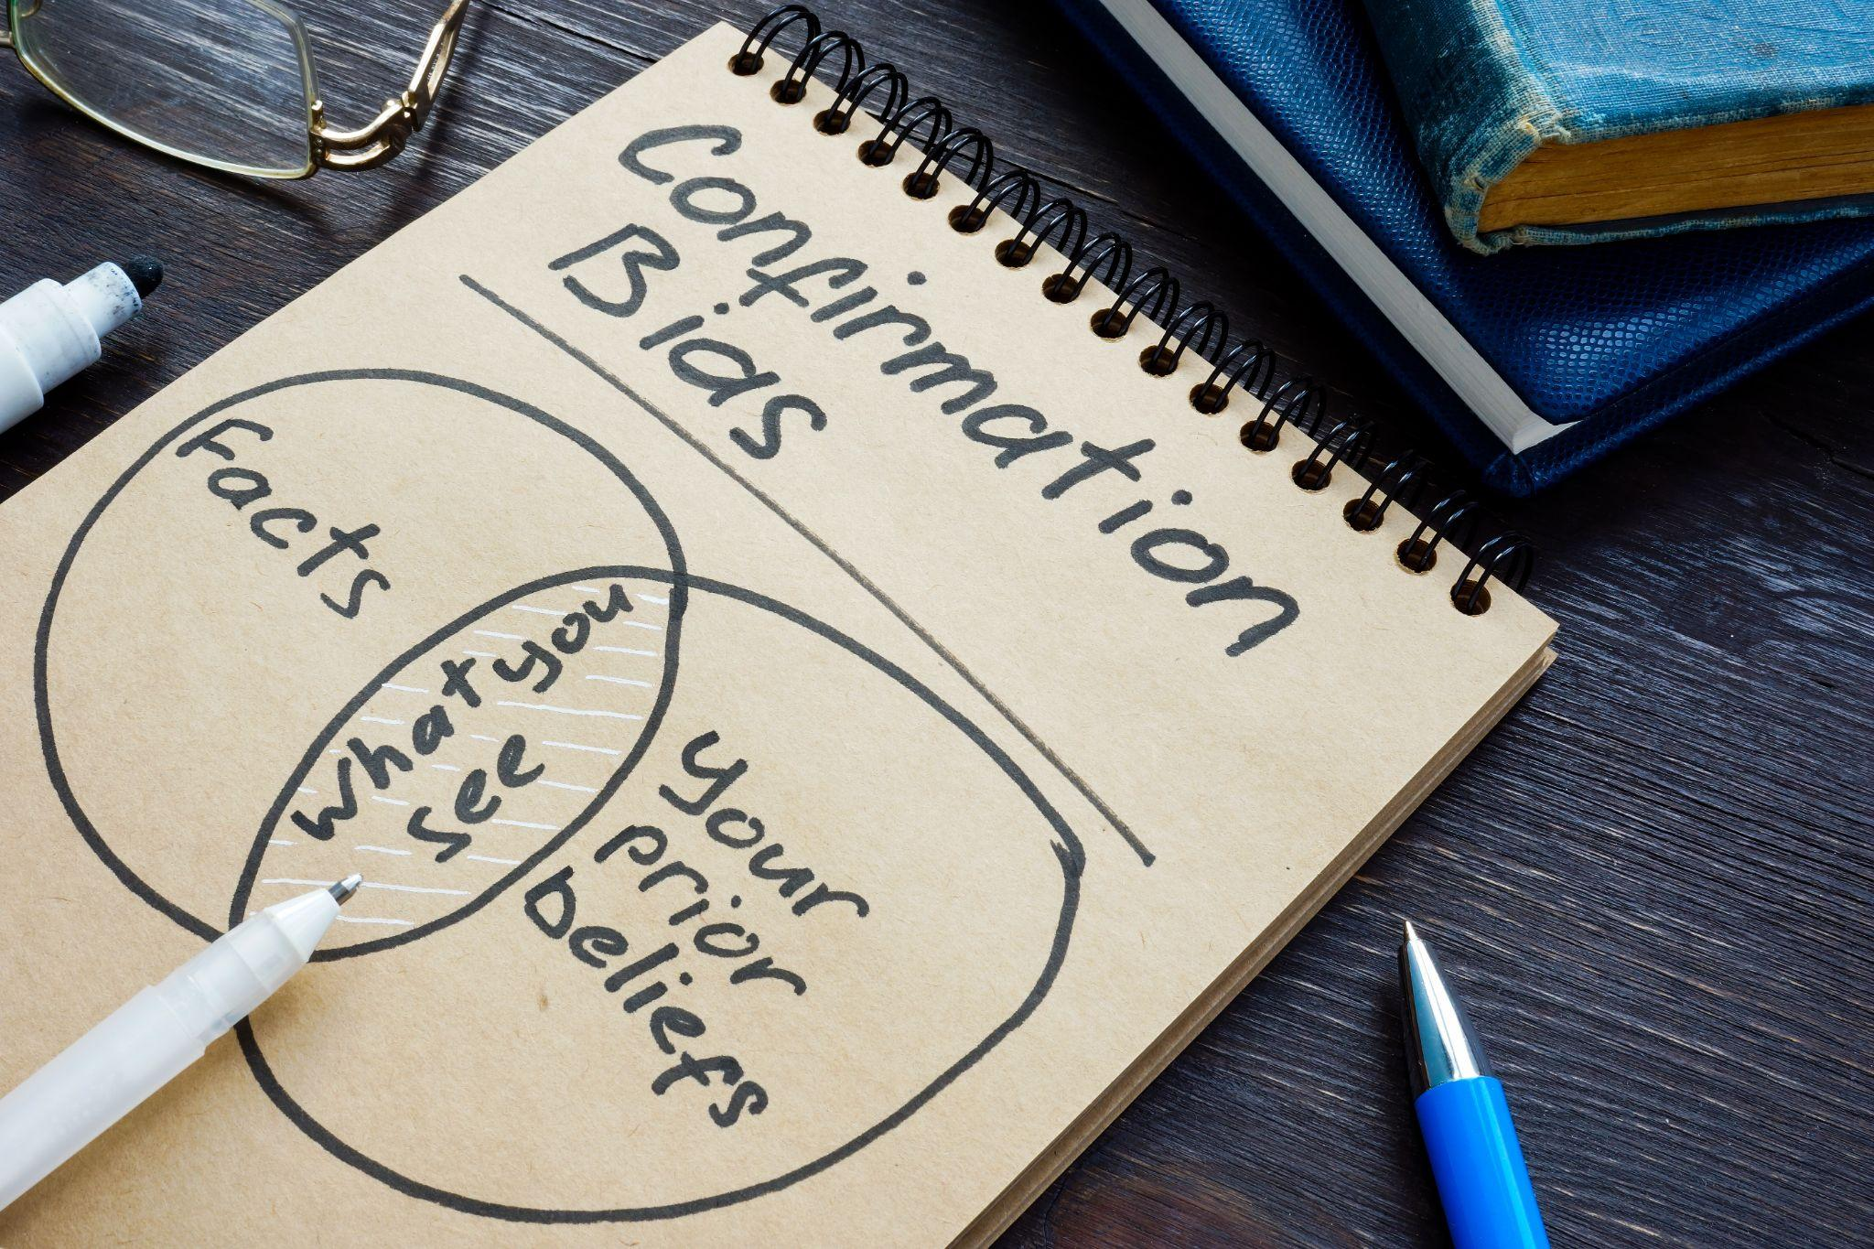
Does Bias really matter?
This work is licensed under a Creative Commons Attribution-NonCommercial-ShareAlike 4.0 International License

Slide 20
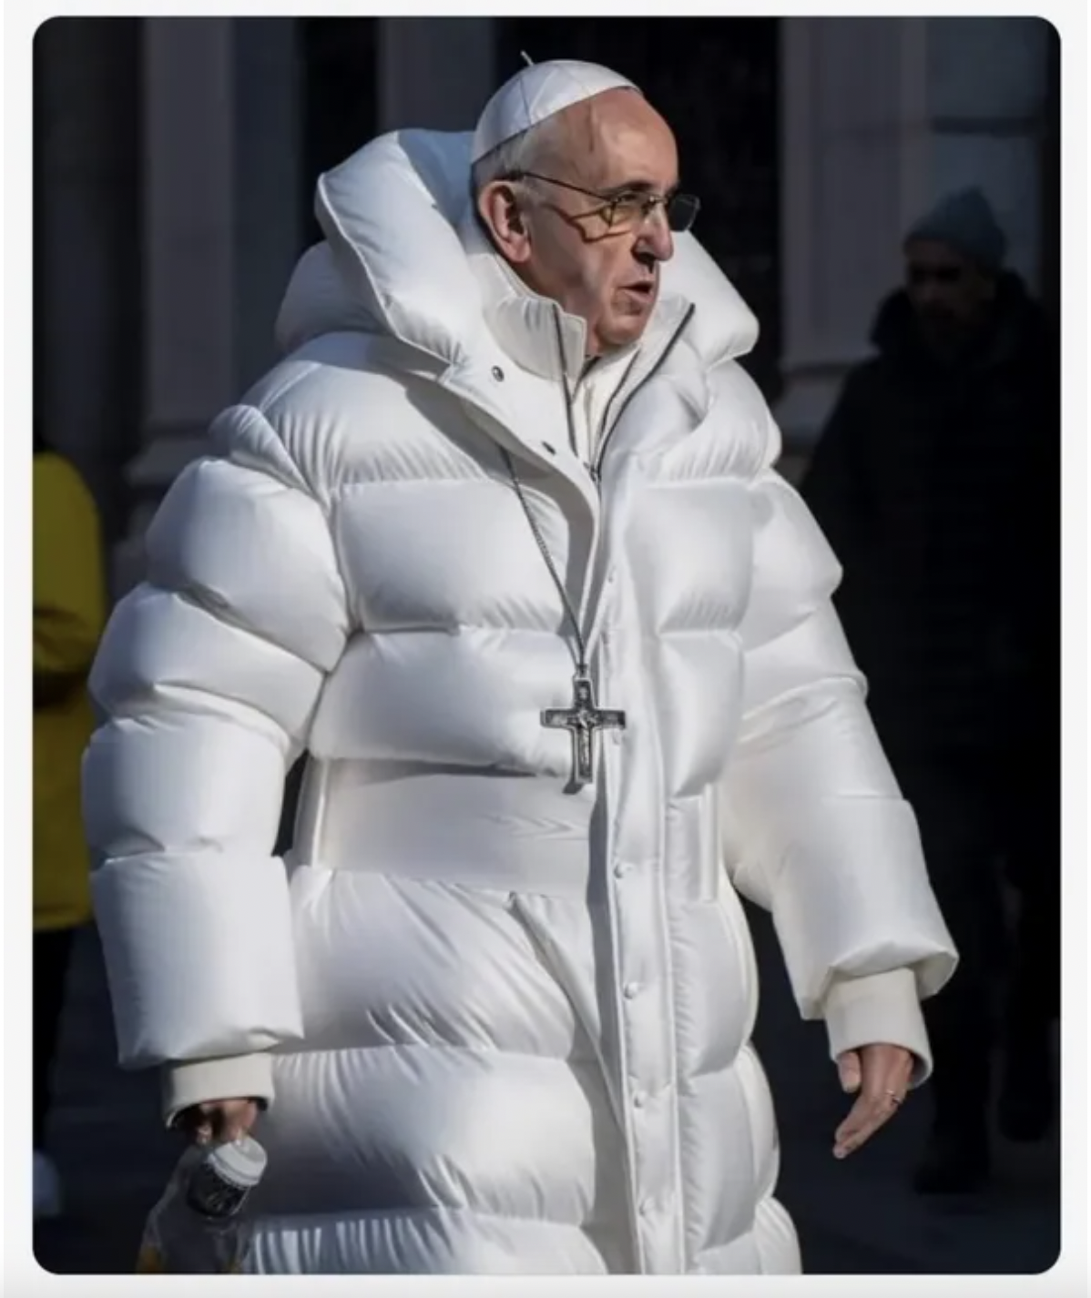
Is AI always used for good?
This work is licensed under a Creative Commons Attribution-NonCommercial-ShareAlike 4.0 International License

Slide 21
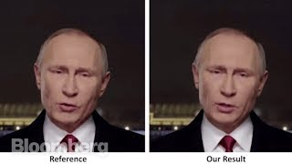
Is AI always used for good?
https://www.youtube.com/watch?v=gLoI9hAX9dw
This work is licensed under a Creative Commons Attribution-NonCommercial-ShareAlike 4.0 International License

Slide 22
Detecting Deepfakes
How good are you at spotting a real image from an AI-generated fake?
Detect Fakes
https://detectfakes.media.mit.edu/
This work is licensed under a Creative Commons Attribution-NonCommercial-ShareAlike 4.0 International License

Slide 23
Deepfakes
Could Deepfakes be used for good?
This work is licensed under a Creative Commons Attribution-NonCommercial-ShareAlike 4.0 International License

Slide 24

What’s your data worth?
This work is licensed under a Creative Commons Attribution-NonCommercial-ShareAlike 4.0 International License

Slide 25
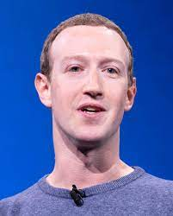
Do you care about your data?
Do you mind that Mark Zuckerberg knows your name?
Do you mind that he can see your Insta/WhatsApp account
(even though you didn’t add him as a friend)?
Do you mind that he knows your top 5 friends?
Do you mind that he knows your top 5 posts?
What about if he knows how you reacted to others’ posts?
What about your DMs?
This work is licensed under a Creative Commons Attribution-NonCommercial-ShareAlike 4.0 International License

Slide 26

Do you care about your data?
Do you mind that your teacher knows your name?
Do you mind that (s)he can see your Insta/WhatsApp account
(even though you didn’t add him as a friend)?
Do you mind that (s)he knows your top 5 friends?
Do you mind that (s)he knows your top 5 posts?
What about if (s)he knows how you reacted to others’ posts?
What about your DMs?
This work is licensed under a Creative Commons Attribution-NonCommercial-ShareAlike 4.0 International License

Slide 27
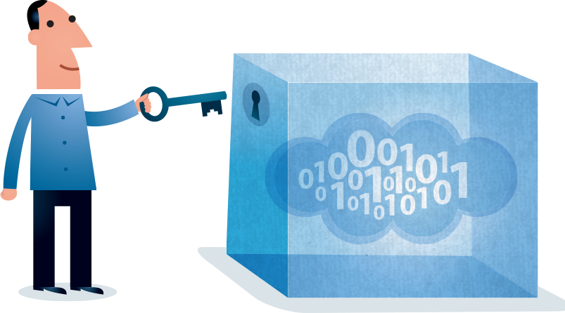
Protecting Your Data while using AI Tools
This work is licensed under a Creative Commons Attribution-NonCommercial-ShareAlike 4.0 International License

Slide 28
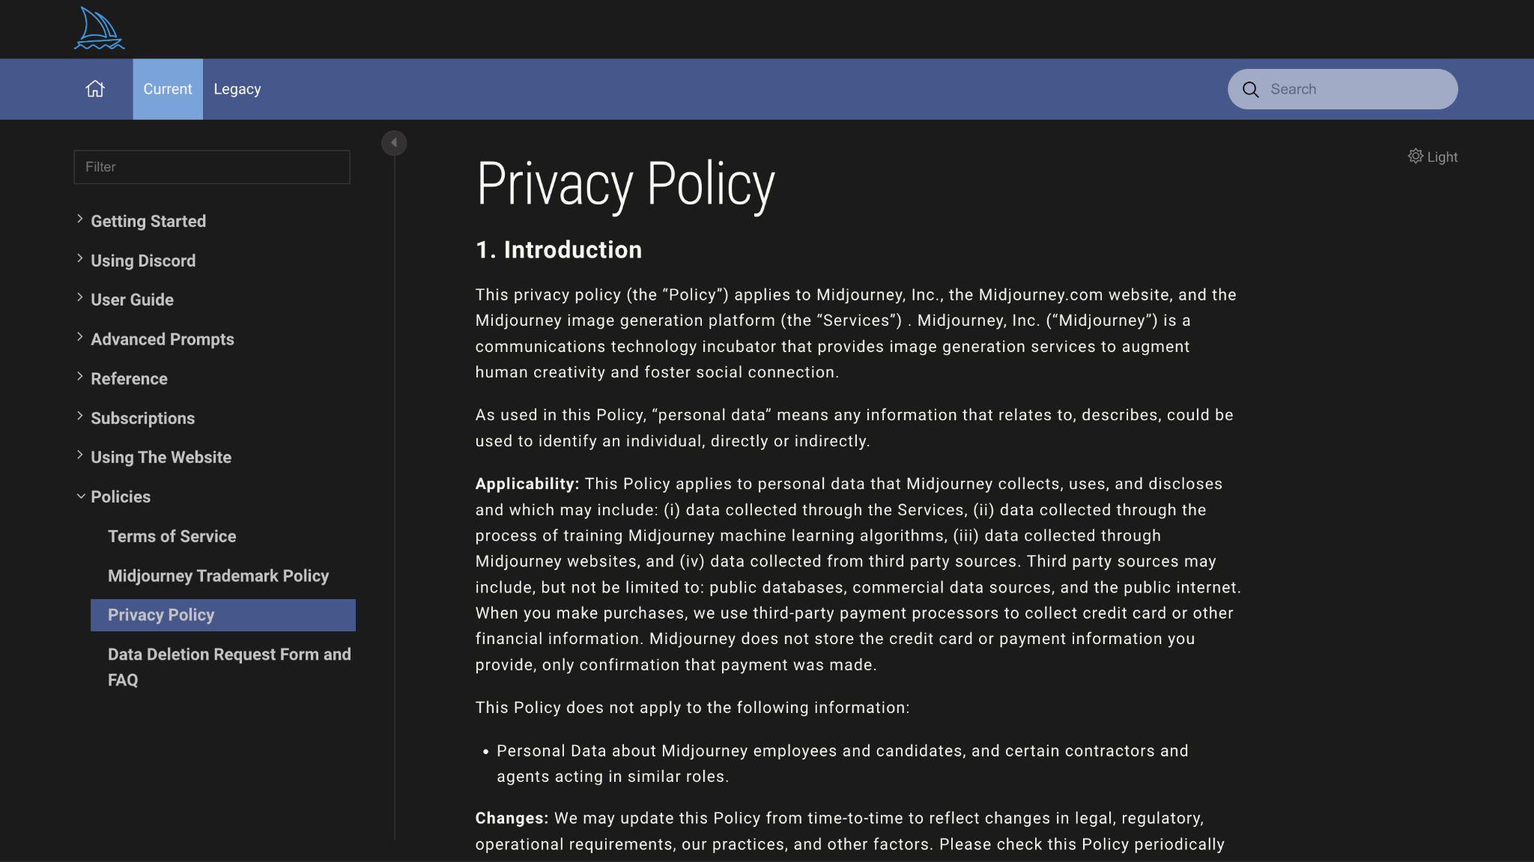

Protecting Your Data while using AI Tools
Always Check the Privacy Policy Before Use
Midjourney privacy policy: https://docs.midjourney.com/docs/privacy-policy
Tips adapted from: https://www.wired.co.uk/article/how-to-use-ai-tools-protect-privacy
This work is licensed under a Creative Commons Attribution-NonCommercial-ShareAlike 4.0 International License

Slide 29
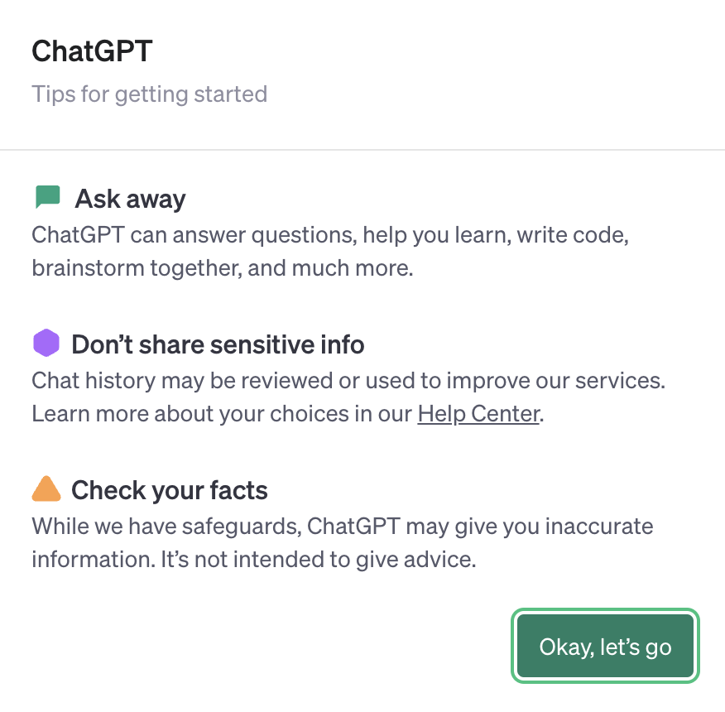

Protecting Your Data while using AI Tools
2. Watch what you share
Tips adapted from: https://www.wired.co.uk/article/how-to-use-ai-tools-protect-privacy
OpenAI privacy policy: https://openai.com/policies/privacy-policy
This work is licensed under a Creative Commons Attribution-NonCommercial-ShareAlike 4.0 International License

Slide 30
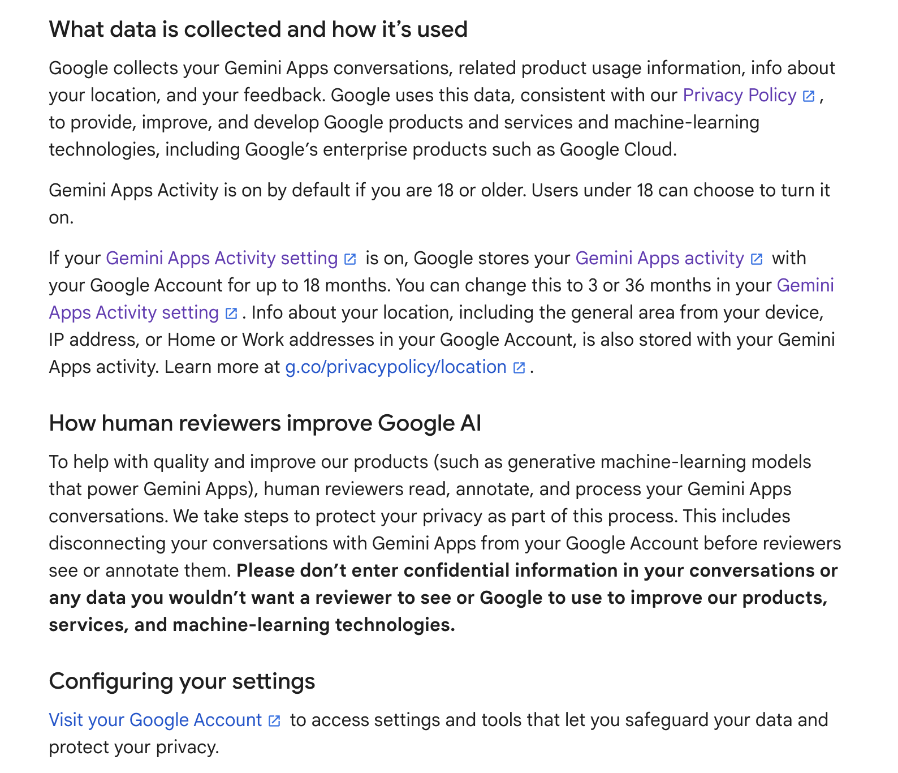

Protecting Your Data while using AI Tools
3. Change your settings
Tips adapted from: https://www.wired.co.uk/article/how-to-use-ai-tools-protect-privacy
Google Privacy Policy: https://policies.google.com/privacy
This work is licensed under a Creative Commons Attribution-NonCommercial-ShareAlike 4.0 International License

Slide 31
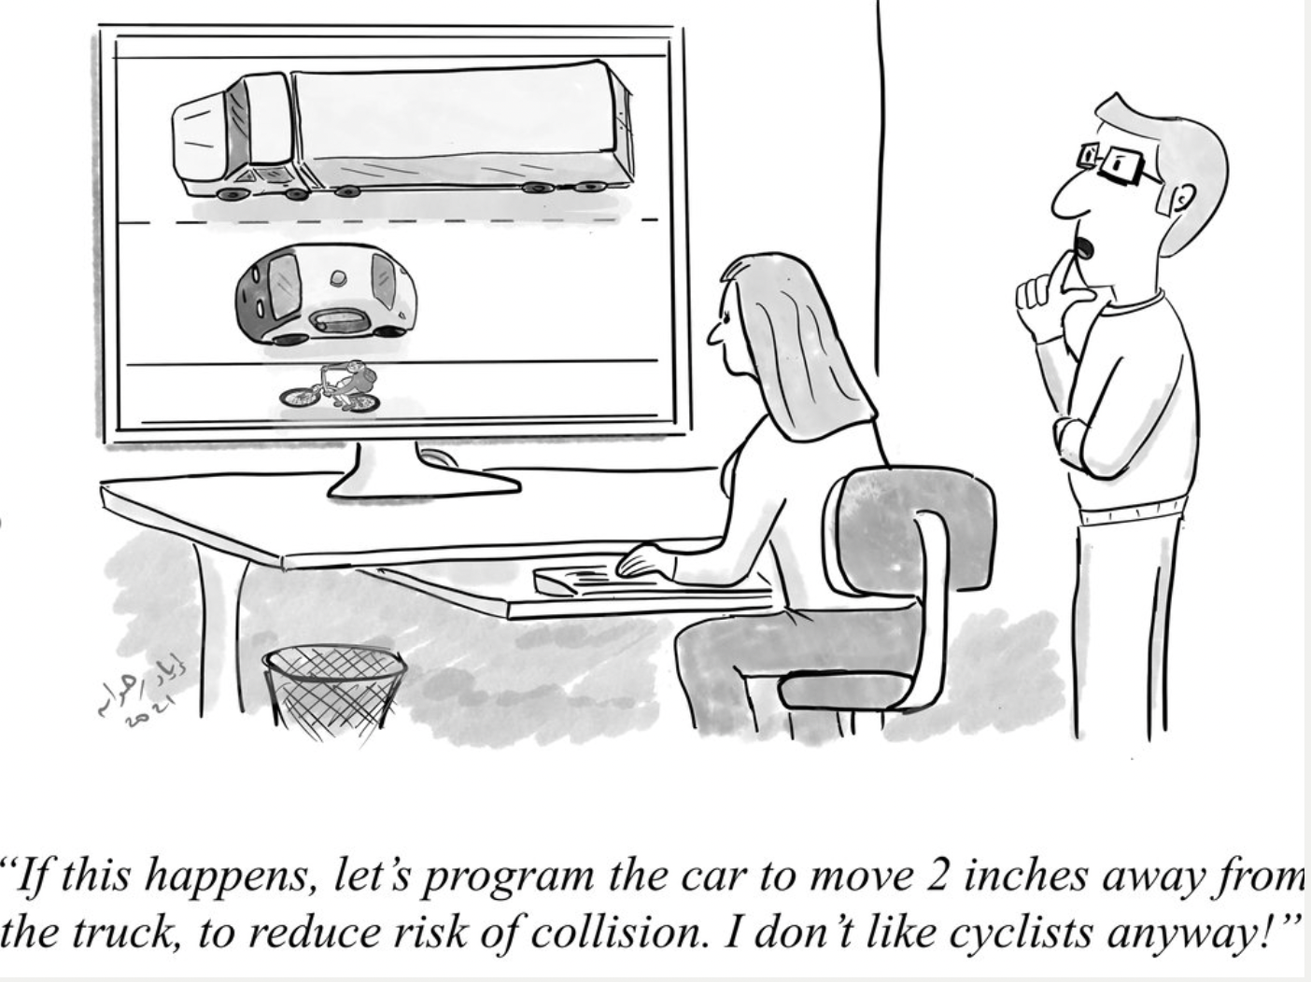
AI and Ethics
Source: https://www.evilaicartoons.com
This work is licensed under a Creative Commons Attribution-NonCommercial-ShareAlike 4.0 International License

Slide 32
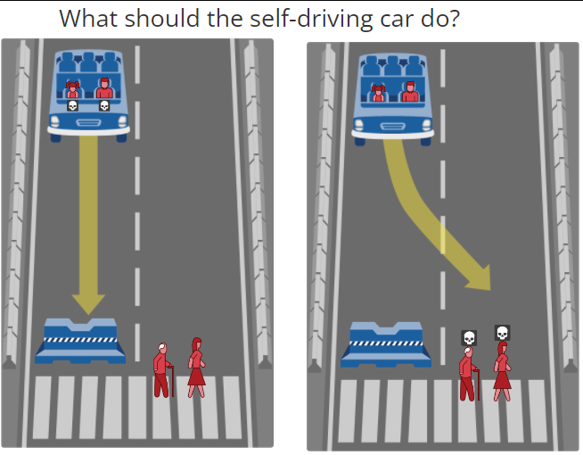
Ethical Decisions of AI
The self-driving car with sudden brake failure will continue ahead and crash into a barrier killing a middle aged man and his young daughter
The self-driving car with sudden brake failure will continue ahead and crash into a barrier killing an elderly man and a middle aged woman
https://www.moralmachine.net
This work is licensed under a Creative Commons Attribution-NonCommercial-ShareAlike 4.0 International License

Slide 33
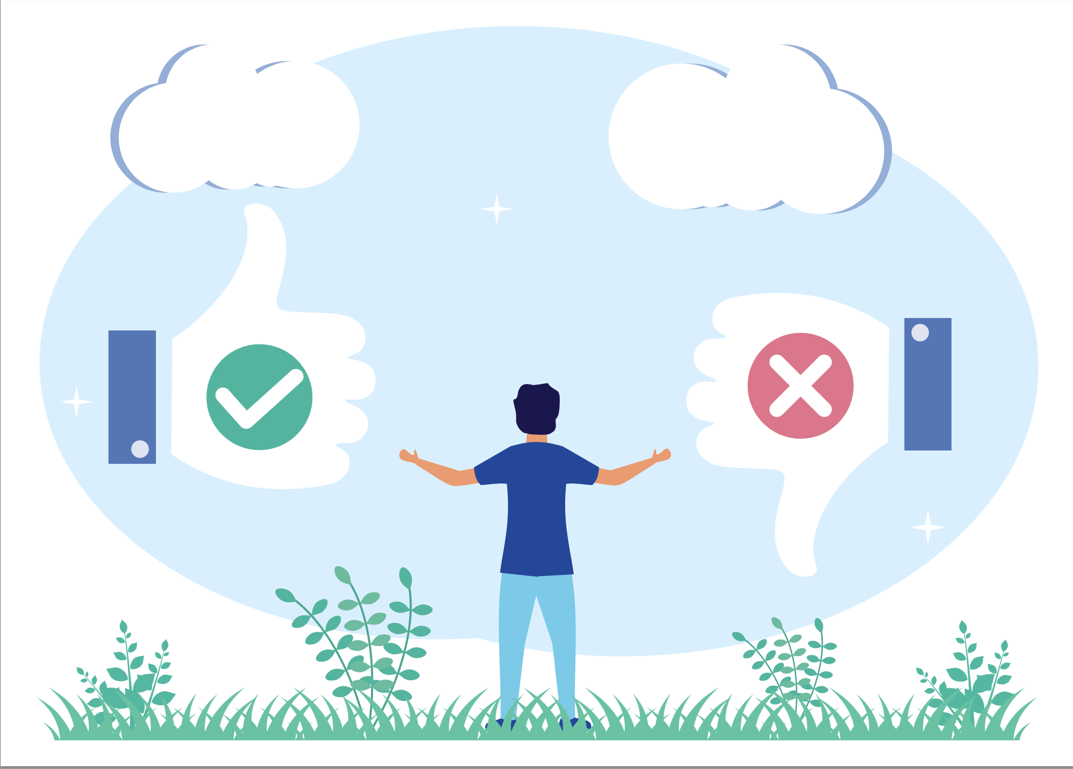
The Key Message
AI offers substantial benefits to individuals and society
These benefits must be balanced with the potential ethical implications of AI
This work is licensed under a Creative Commons Attribution-NonCommercial-ShareAlike 4.0 International License

Slide 34
What have we learned?
AI is transforming our lives
The influence of AI is growing constantly
We need to balance the benefits with the drawbacks
You need to be ready for the ‘Age of AI’
This work is licensed under a Creative Commons Attribution-NonCommercial-ShareAlike 4.0 International License

Slide 35
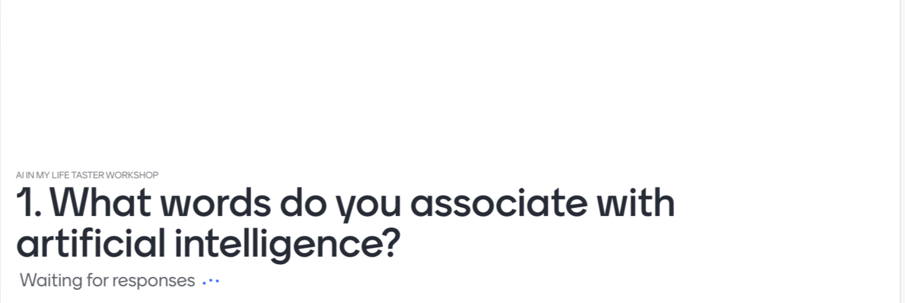

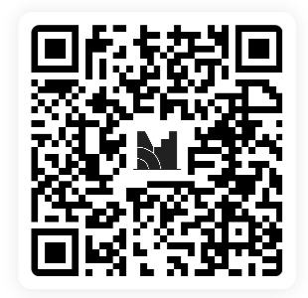
This work is licensed under a Creative Commons Attribution-NonCommercial-ShareAlike 4.0 International License
This work is licensed under a Creative Commons Attribution-NonCommercial-ShareAlike 4.0 International License

Slide 36
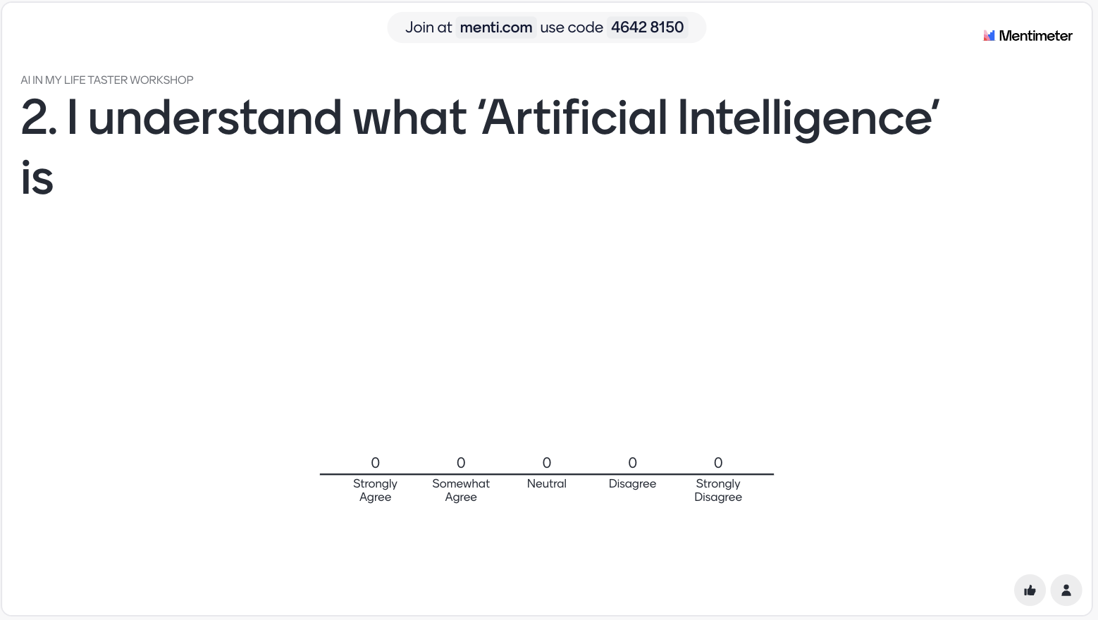
This work is licensed under a Creative Commons Attribution-NonCommercial-ShareAlike 4.0 International License
This work is licensed under a Creative Commons Attribution-NonCommercial-ShareAlike 4.0 International License

Slide 37
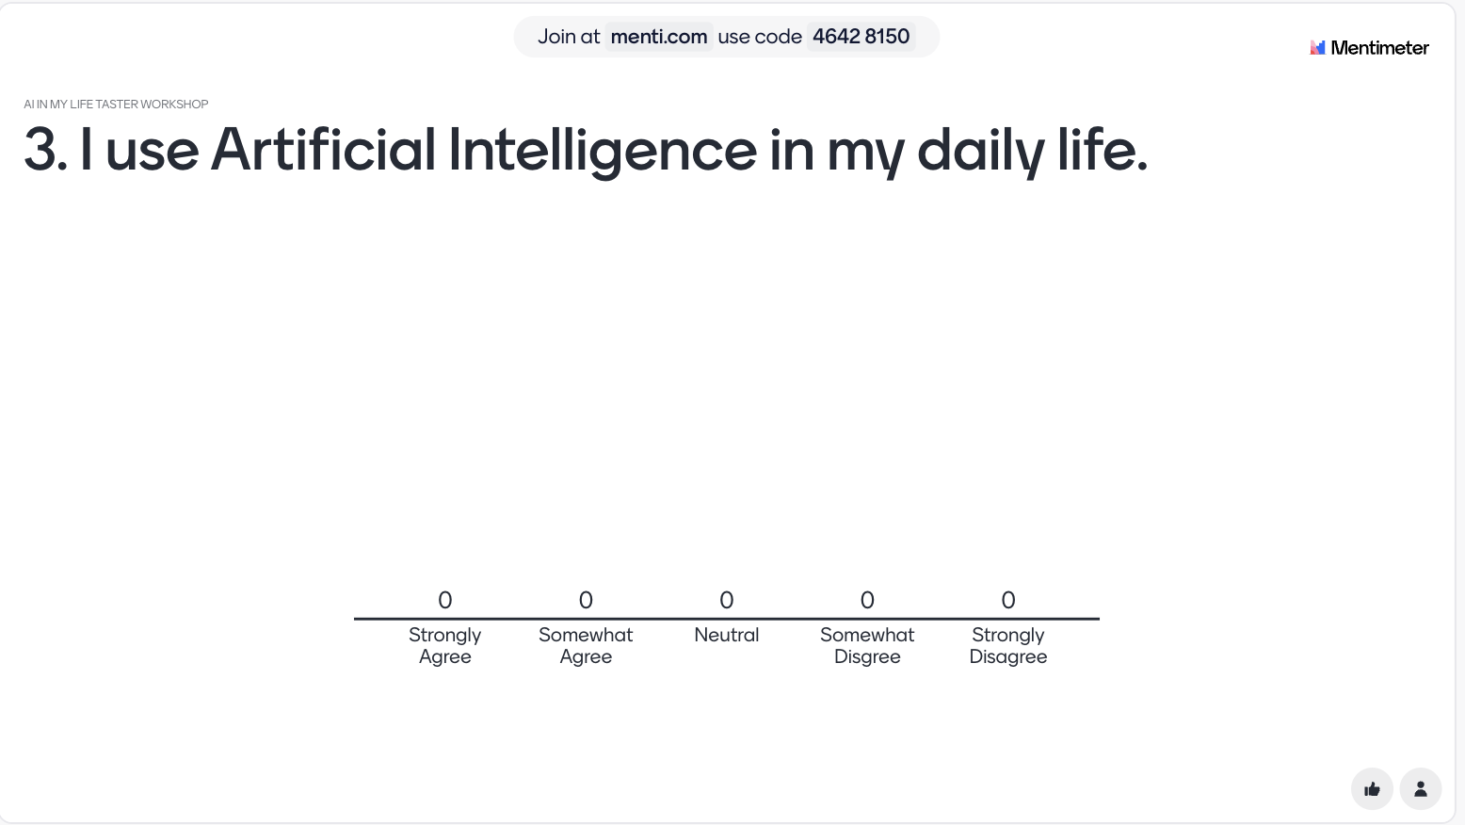
Please continue right to the end of the survey (8 questions)
This work is licensed under a Creative Commons Attribution-NonCommercial-ShareAlike 4.0 International License
This work is licensed under a Creative Commons Attribution-NonCommercial-ShareAlike 4.0 International License

Slide 38
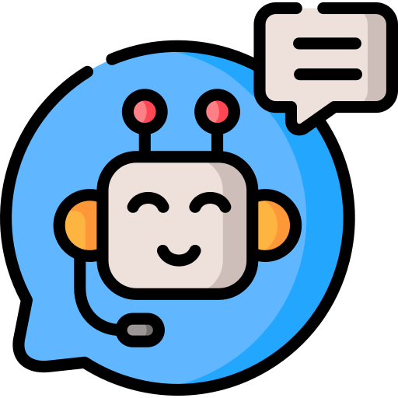
Thanks to our partners:
Want to find out more about AI?
Sign up for more AI in My Life modules at:
www.adaptcentre.ie/ai-in-my-life/
education@adaptcentre.ie
This work is licensed under a Creative Commons Attribution-NonCommercial-ShareAlike 4.0 International License

