Slide 1
Lesson 1
Introduction to ethics and doing

Slide 2
What is Ethics?
Have you heard this word before?
What does ‘ethics’ mean to you?
How do we know what is right and wrong?
Where do we learn about this?
Is it difficult to always do the right thing?

Slide 3
Ethics is concerned with what is morally good and bad, and what is morally right and wrong

Slide 4
This can be difficult to figure out ! Why do you think this is difficult?

Slide 5
Is it ethical to allow hunters to shoot a black rhino?

Slide 6
Zine Time ! What is a Zine?
Let’s make a Zine!

Slide 7
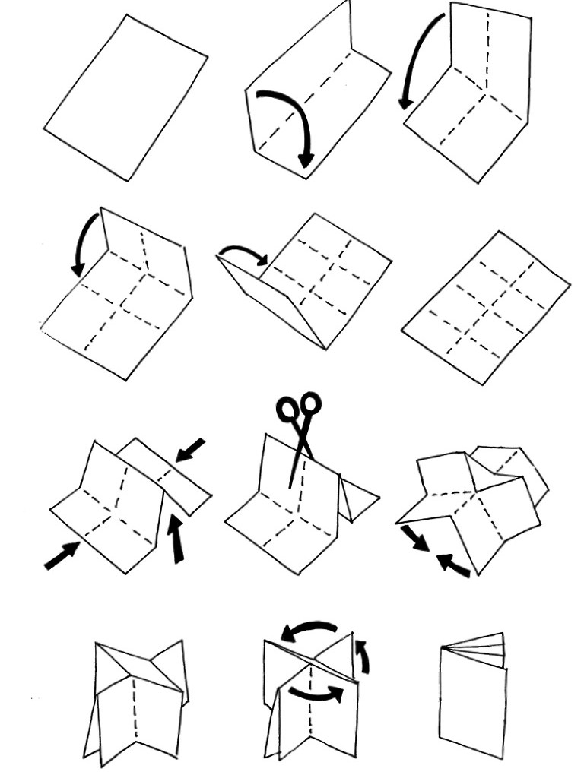
How to fold a Zine

Slide 8
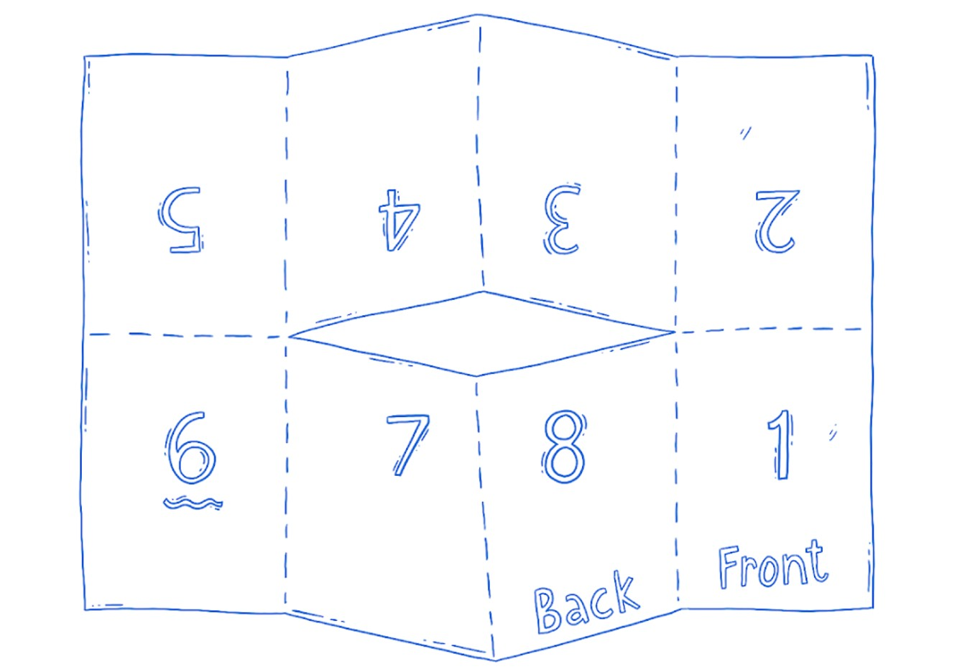

Slide 9
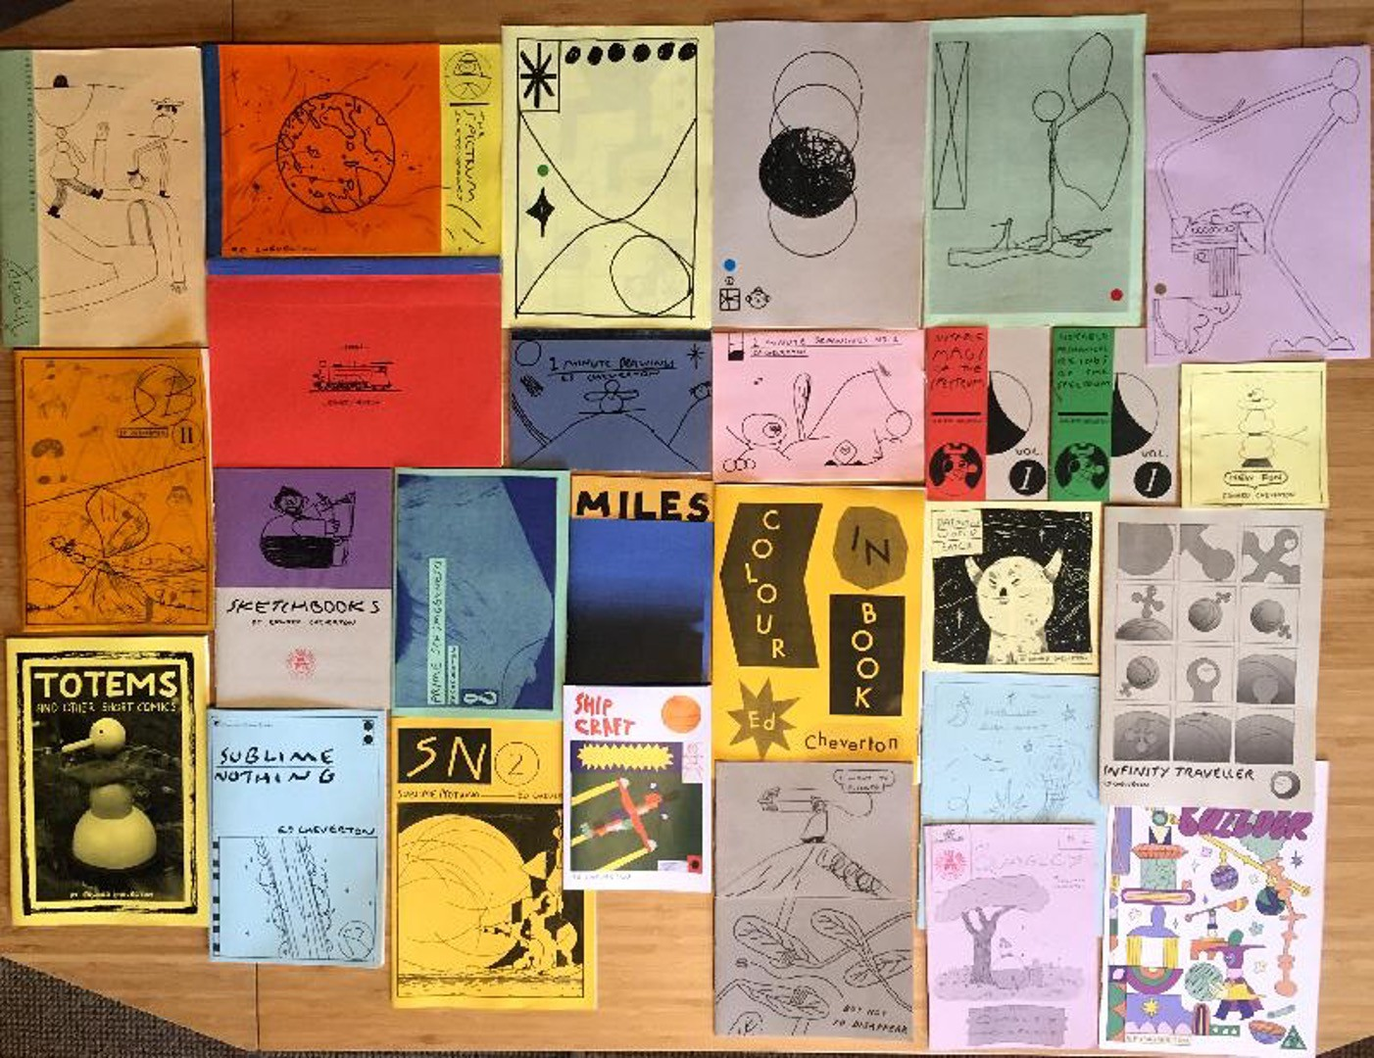

Slide 10
Class Activity!
Use your Zine to draw, write or make a collage about what you think is ethical and unethical

Slide 11
Let’s discuss our Zines !
Let’s display our Zines for everyone to see!

